Slide 1
Data Preprocessing in Data Mining

Slide 2
Real-world data is often incomplete, noisy, and inconsistent, which can lead to incorrect results if used directly. Data preprocessing in data mining is the process of cleaning and preparing raw data so it can be used effectively for analysis and model building.
Real-world data is often incomplete, noisy, and inconsistent, which can lead to incorrect results if used directly. Data preprocessing in data mining is the process of cleaning and preparing raw data so it can be used effectively for analysis and model building.

Slide 3
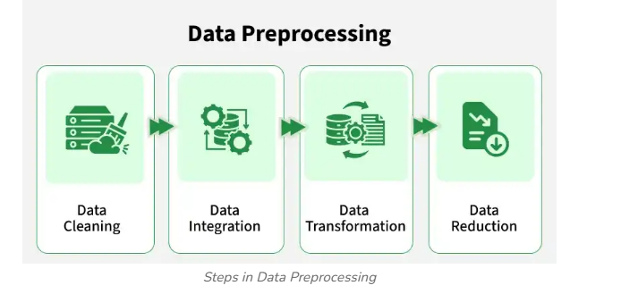
Steps in Data Preprocessing

Slide 4
1. Data Cleaning
It is the process of identifying and correcting errors or inconsistencies in the dataset. Its common tasks include:
Handling missing values
Removing duplicate records
Correcting wrong or inconsistent data
Handling Outliers

Slide 5
Techniques used:
Mean Imputation: Replaces missing values with the average of the attribute.
Median Imputation: Replaces missing values with the middle value, useful when outliers exist.
Mode Imputation: Replaces missing values with the most frequent value.
Deletion Method: Removes records that contain missing values.
Interquartile Range (IQR): Detects outliers using the range between Q1 and Q3.

Slide 6
Z-Score Method: Identifies outliers based on standard deviation from the mean.
Binning: Smooths noisy data by grouping values into bins.
Regression Smoothing: Uses regression to predict and smooth noisy values.
Duplicate Detection: Identifies and removes repeated records.
Example:
Replacing missing age values with the average age
Removing repeated rows in a dataset

Slide 7
Mean Imputation
Mean Imputation
Name | Age
Ram | 20
Ravi | NaN
Sita | 22
Hari | 24
df['Age'].fillna(df['Age'].mean())
(20 + 22 + 24) / 3 = 22

Slide 8
import pandas as pd
import numpy as np
df = pd.DataFrame({
'Name':['Ram','Ravi','Sita','Hari'],
'Age':[20,np.nan,22,24]
})

Slide 9
df['Age'] = df['Age'].fillna(df['Age'].mean())

Slide 10
Median Imputation Definition
Median imputation replaces missing values with the middle value after sorting the data. It is useful when outliers exist.
20, 21, 22, 100, NaN
Median = 21.5

Slide 11
import pandas as pd
import numpy as np
df = pd.DataFrame({
'Age':[20,21,22,100,np.nan]
})
df['Age'] = df['Age'].fillna(df['Age'].median())
print(df)

Slide 12
Mode Imputation
Mode imputation replaces missing values with the most frequently occurring value.
Gender
Male
Female
Male
NaN
Male
Mode = Male

Slide 13
import pandas as pd
import numpy as np
df = pd.DataFrame({
'Gender':['Male','Female','Male',np.nan,'Male']
})
df['Gender'] = df['Gender'].fillna(df['Gender'].mode()[0])
print(df)

Slide 14
Outlier Detection
To identify these points, apply the following steps:
Order the data: Arrange your data points from smallest to largest.
Find the first quartile (Q₁): This is the median (25th percentile) of the lower half of your data.
Find the third quartile (Q₃): is is the median (75th percentile) of the upper half of your data. [1, 2]
Calculate the IQR: IQR = Q₃ - Q₁.
Determine the boundaries:
Lower Outlier Boundary:
Upper Outlier BoundaryAny value that is less than the Lower Boundary or greater than the Upper Boundary is considered an outlie

Slide 15
Outliers Detection
40, 42, 45, 46, 47, 48, 49, 50, 52, 100
Step 1: Arrange the data
40, 42, 45, 46, 47, 48, 49, 50, 52, 100
Step 2: Find Q1 (First Quartile)
Lower half:40, 42, 45, 46, 47The middle value is:Q1 = 45
Step 3: Find Q3 (Third Quartile)
Upper half:
48, 49, 50, 52, 100
Q3 = 50

Slide 16
Step 4: Calculate IQR
Formula:
IQR = Q3 − Q1
Calculation:
IQR = 50 − 45
= 5

Slide 17
Step 5: Calculate Lower and Upper Limits
Lower Limit
Q1 − 1.5 × IQR
= 45 − 1.5 × 5
= 45 − 7.5
= 37.5

Slide 18
Upper Limit
Q3 + 1.5 × IQR
= 50 + 1.5 × 5
= 50 + 7.5
= 57.5

Slide 19
Step 6: Identify Outliers
Acceptable range:
37.5 ≤ Value ≤ 57.5

Slide 20
Value | Outlier?
40 | No
42 | No
45 | No
46 | No
47 | No
48 | No
49 | No
50 | No
52 | No
100 | Yes

